Slide 1
Unit 3: Atomic Structure and Electrons in the Atom

Slide 2
Table of Contents
Slide #
3 – 14
15 – 22
23 – 30
31 – 41
41 – 52
53 – 70
71 – 75
Topics:
Atomic Theory
Atomic Structure
Isotopes and Average Atomic mass
Energy and the Electromagnetic Spectrum
Calculating energy, wavelength and frequency
Valence Electrons and Electron Configuration
Lewis Electron Dot Structures

Slide 3
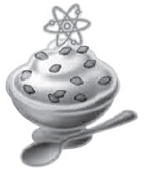
Atomic Theory
C.6.A understand the experimental design and conclusions used in the development of modern atomic theory, including Dalton’s Postulates, Thomson’s discovery of electron properties, Rutherford’s nuclear atom, and Bohr’s nuclear atom

Slide 4
Atomic Theory
Atomic theory ---the idea that all matter is made up of atoms. It is a very old idea dating back to the ancient Greeks. Over time, scientists have come up with various models for the atom based on their observations. These atomic models have been altered and revise as new scientific evidence is discovered.

Slide 5
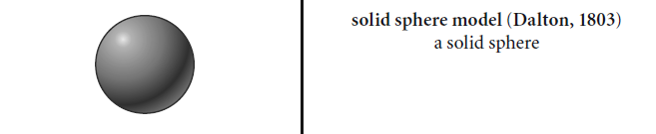
John Dalton (1803)
  Dalton’s Postulates:
  -Atoms can’t be subdivided (False)
  -Atoms of the same element have the same properties
  -Atoms aren’t created or destroyed in chemical reactions
  -All molecules of the same compound have the same composition
  -Atoms combine in definite proportions to form compounds

Slide 6
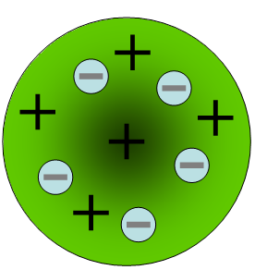
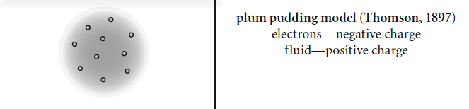

JJ Thompson (1897)
  - Discovered negatively charged particles with the cathode ray tube (electrons).
  - Measured the charge to mass ratio of the electron
  - Knew there had to be other particles in atoms (because of the mass).

Slide 7
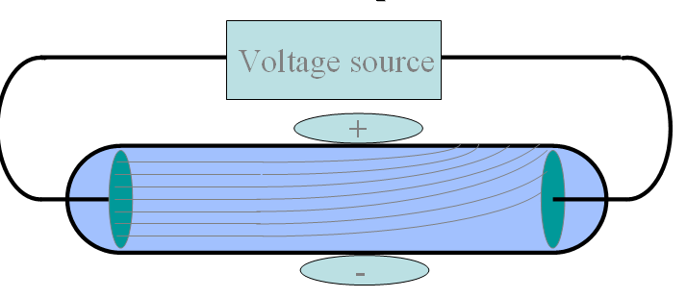
Cathode Ray Tube
  Passing an electric current through the cathode makes a beam appear to move from the negative to the positive end. Electrons are negatively charged and are attracted to a positive magnetic source.
http://highered.mcgraw-hill.com/sites/0072512644/student_view0/chapter2/animations_center.html#
Watch “Intro” and “Determine charge to mass ratio” of Cathode Ray Tube

Slide 8
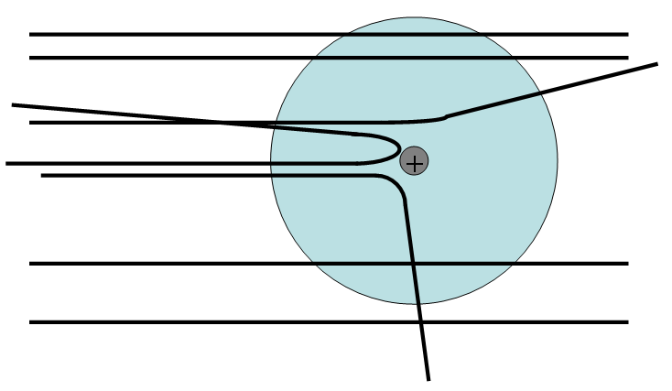
Ernest Rutherford (1911 & 1918)
Atom is mostly empty space with a small, positive dense mass at center (nucleus) - 1911
Rutherford is generally credited with the discovery of the proton, though he was not able to isolate it from the neutrons within the nucleus. - 1918
  Alpha particles are deflected if they get close enough to the nucleus

Slide 9
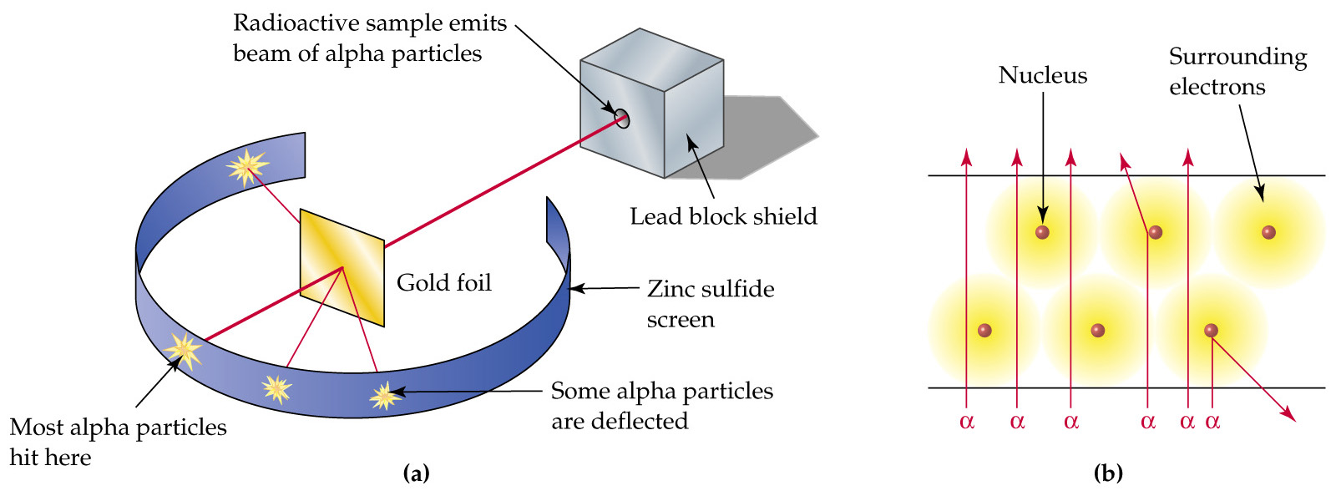
Gold Foil Experiment (1911)
Rutherford's 'gold foil' experiment performed by Hans Geiger and Ernest Marsden using positively charged alpha particles:
  Most alpha particles passed through the gold foil suggesting that an atom is largely empty space.
  Some alpha particles were deflected significantly suggesting that the positive charge of an atom must be concentrated in a very small sphere.
  A very small number of alpha particles actually bounced back.

Slide 10

Rutherford’s Gold Foil Experiment

Slide 11
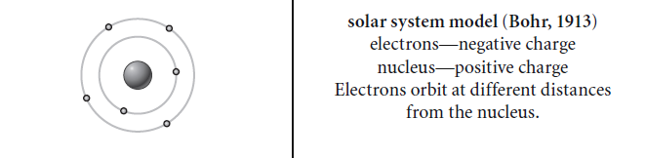
Niels Bohr (1913)
Niels Bohr stated that electrons move in different orbits, or energy levels, around the nucleus like planets orbit the sun.
  An electron can absorb energy and move to a higher energy orbit of larger radius. (excited electrons)
  An excited electron can fall back to its original orbit by emitting energy as radiation.
  Electrons can only exist in certain discrete energy levels.

Slide 12
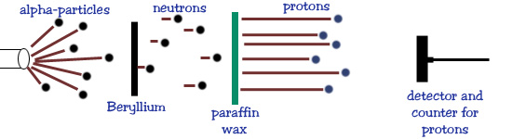
James Chadwick (1935)
Chadwick discovered the neutron which is a particle with no charge that is also located in the nucleus.
  Bombarded beryllium with alpha particles and discovered Rutherford's missing neutral particles.
  Shared Nobel Prize for the discovery of the neutron

Slide 13
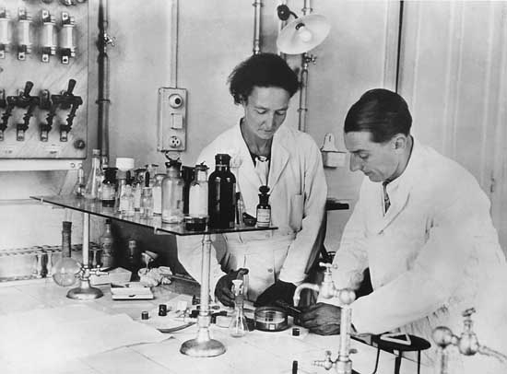
Frédéric Joliot and Irène Joliot-Curie (1935)
Frédéric Joliot and Irène Joliot-Curie worked on the projection of nuclei in 1934, which was an essential step in the discovery of the neutron.

Slide 14
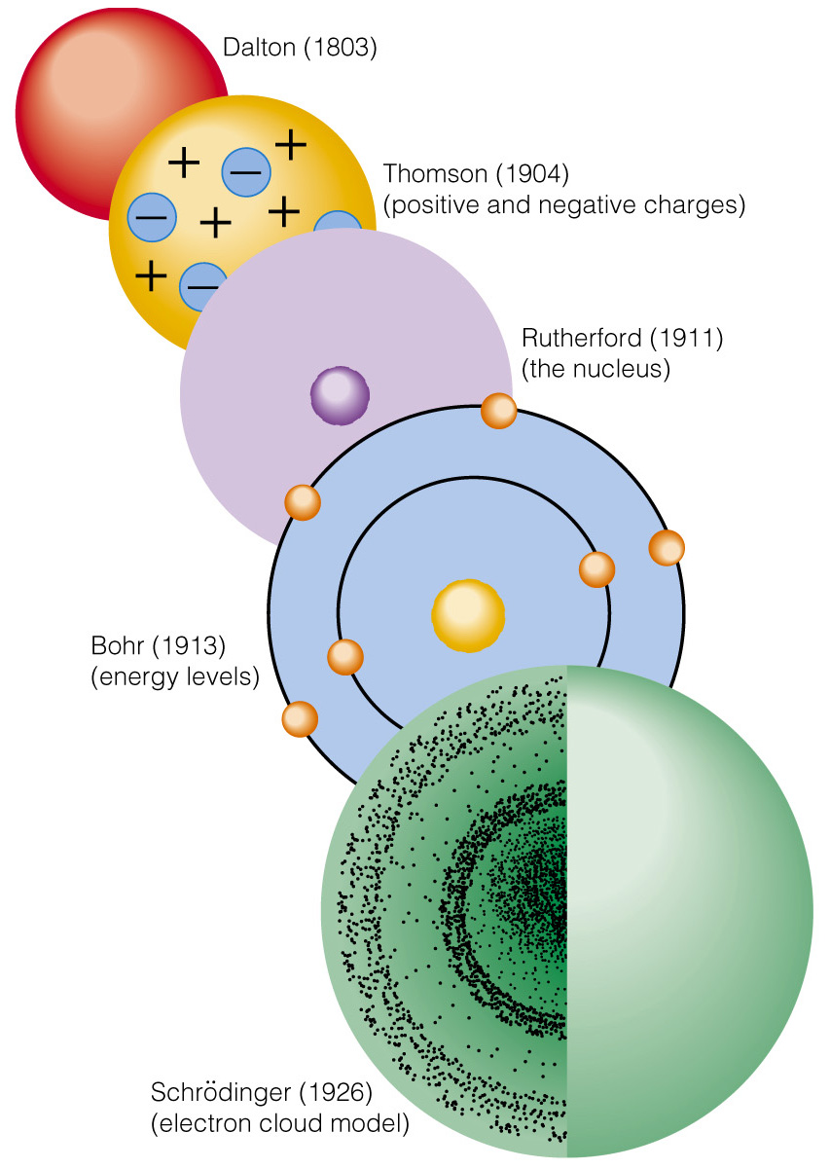

Stop at this slide
The advancement of the atomic model

Slide 15
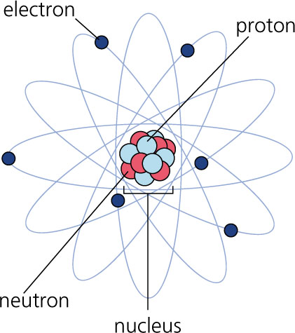
Atomic Structure
C.6.A understand the experimental design and conclusions used in the development of modern atomic theory, including Dalton’s Postulates, Thomson’s discovery of electron properties, Rutherford’s nuclear atom, and Bohr’s nuclear atom

Slide 16
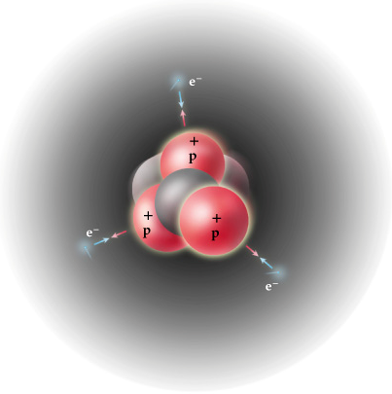
The Proton
Proton
  It’s a particle located in the nucleus of an atom.
  It has a charge of positive 1 and a mass of 1 amu (atomic mass units).
  Protons are almost identical in size to neutrons.
The protons determine the element.
  The number of protons will tell you what element it is.
    An atom having 6 protons will always be Carbon, C.
    The atomic number is the same as the number of protons.

Slide 17
The Electron
Electron
  It’s a particle located around the nucleus of an atom.
  It has a charge of -1 and a mass of 0 amu (atomic mass units).
  Electron are very small, they are 1/1,835th the size of a proton.
In a neutral atom, the number of electrons are the same as the atomic number.
  If an atom becomes an ion , the number of electrons changes creating a charged atom.

Slide 18
The Neutron
Neutron
  It’s a particle located in the nucleus of an atom.
  It has a charge of 0 and a mass of 1 amu (atomic mass units).
  Neutrons are almost identical in size to protons.
Number of neutrons depends on the mass number.

Slide 19

Mass Number
Mass number is the number of protons plus neutrons.
  Mass number is found by adding protons and neutrons.
    3 protons + 4 neutrons = 7 (Lithium)
  Or can be found by rounding atomic mass to the nearest whole number.
    Iodine atomic mass is 126.9044 so its mass number is 127.
Mass number can be used to calculate neutrons in an atom.
  Iodine mass # 127 – Iodine atomic # 53 = 74 neutrons.

Slide 20
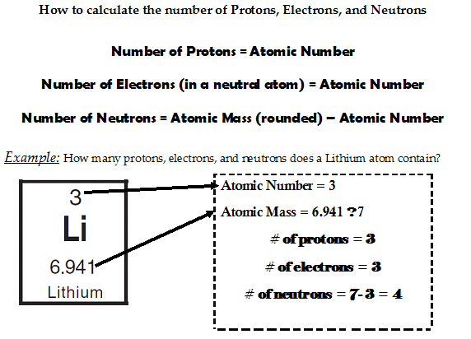
Calculating Particles in an Atom
Atomic Number = 3
Atomic Mass = 6.941 ≈ 7 = Mass #
# of protons = 3
# of electrons = 3
# of neutrons = 7 3 = 4

Slide 21
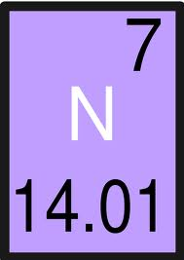
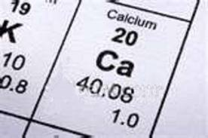
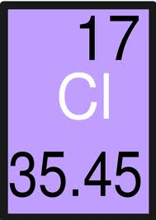
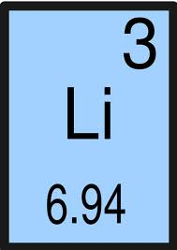
ELEMENT | # of protons | # of electrons | # of neutrons
Nitrogen
Calcium
Chlorine
Lithium

Slide 22
Stop at this Slide

Slide 23
Isotopes and Average Atomic Mass
C.6.D use isotopic composition to calculate average atomic mass of an element.

Slide 24
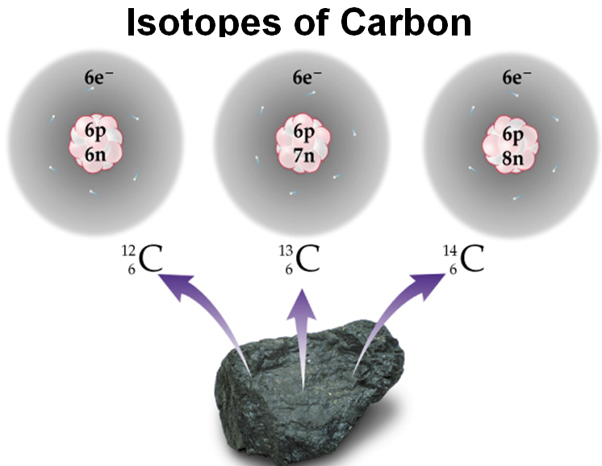
Isotopes
Isotopes are atoms of the same element with different masses.
  Changing the number of neutrons and the mass number gives you different isotopes of the same type of atom.
    Such as those of Carbon:
      K
      J k
      k

Slide 25
Isotopes
Calculate the protons, neutrons, and electrons in these isotopes of chlorine.
chlorine - 35 chlorine - 37
  Protons
  Electrons
  Neutrons

Slide 26
Average Atomic Mass
Average atomic mass is based on all the isotopes of an element and their abundance %.
  Atomic mass is not a whole number … mass number is a whole number
  Weighted average =mass isotope 1 x (%) + mass isotope 2 x (%) + … 100 100

Slide 27
Calculating Average Atomic Mass
Isotopes Mass of Isotope Abundance
²⁴Mg = 24.0 amu 78.70%
²⁵Mg = 25.0 amu 10.13%
²⁶Mg = 26.0 amu 11.17%
In order to calculate average atomic mass, multiply each isotopes’ mass by the abundance (%/100). Then add all together to get the final atomic mass.
(24)(.787) + (25)(.1013) + 26(.1117) =
18.888 + 2.5325 + 2.9042 = 24.3 amu

Slide 28
Example
The mass of a Cu-63 atom is 62.94 amu, and that of a Cu-65 atom is 64.93 amu. The percent abundance of Cu-63 is 69.17% and the percent abundance of Cu-65 is 30.83%. What is the average atomic mass of Cu?

Slide 29
Example
The mass of a Cu-63 atom is 62.94 amu, and that of a Cu-65 atom is 64.93 amu. The percent abundance of Cu-63 is 69.17% and the percent abundance of Cu-65 is 30.83%. What is the average atomic mass?
Step 1: Find the contribution of each isotope:
  Cu-63: (62.94 amu) x (0.6917) = 43.535598 amu
Cu-65: (64.93 amu) x (0.3083) = 20.017919 amu
Step 2: Add the relative abundances from each isotope together.
  43.535598 amu + 20.017919 amu = 63.553517 amu
  Round answer to two numbers after the decimal: 63.55 amu

Slide 30
Stop at this slide

Slide 31
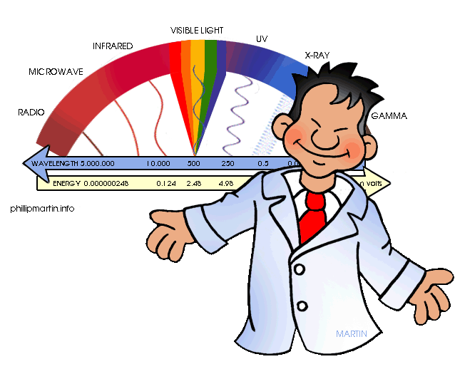
Energy and the Electromagnetic Spectrum
C.6.B understand the electromagnetic spectrum and the mathematical relationships between energy, frequency, and wavelength of light

Slide 32
Energy and Light
Classical View Of the Universe
The Nature of Light – Wave Nature
Matter has mass and volume
Energy is not composed of particles.
Energy can only travel in waves.
Light is a form of electromagnetic radiation.
Electromagnetic radiation is made of waves called photons; traveling at “c”
Electromagnetic radiation moves through space like waves move across the surface of a pond

Slide 33
Electromagnetic Waves
Every wave has four characteristics that determine its properties:
  wave speed, v
  height (amplitude),
  wavelength, λ
  number of wave peaks that pass in 1 second, ƒ
All electromagnetic waves move through space at the same, constant speed.
  3.00 x 10⁸ meters per second in a vacuum = The speed of light, c.

Slide 34
Characterizing Waves
The amplitude is the height of the wave.
  The distance from node to crest.
  The amplitude is a measure of how intense the light is—the larger the amplitude, the brighter the light.
The wavelength (λ) is a measure of the distance covered by the wave.
  The distance from one crest to the next.
    Or the distance from one trough to the next, or the distance between alternate nodes.
    It is actually one full cycle, 2π
  Usually measured in nanometers.
    1 nm = 1 x 10⁻⁹ m

Slide 35
Characterizing Waves
The frequency (f) is the number of waves that pass a point in a given period of time.
  The number of waves = number of cycles.
  Units are hertz (Hz), or cycles/s = s⁻¹.
    1 Hz = 1 s⁻¹
The total energy is proportional to the amplitude and frequency of the waves.
  The larger the wave amplitude, the more force it has.
  The more frequently the waves strike, the more total force there is.

Slide 36
λ
amplitude
λ
amplitude
λ

Slide 37
The Electromagnetic Spectrum
The electromagnetic spectrum is the range of all possible frequencies of electromagnetic radiation .
  The color of the light is determined by its wavelength.
The electromagnetic spectrum extends from low frequencies used for modern radio communication to gamma radiation at the short-wavelength (high-frequency) end.

Slide 38
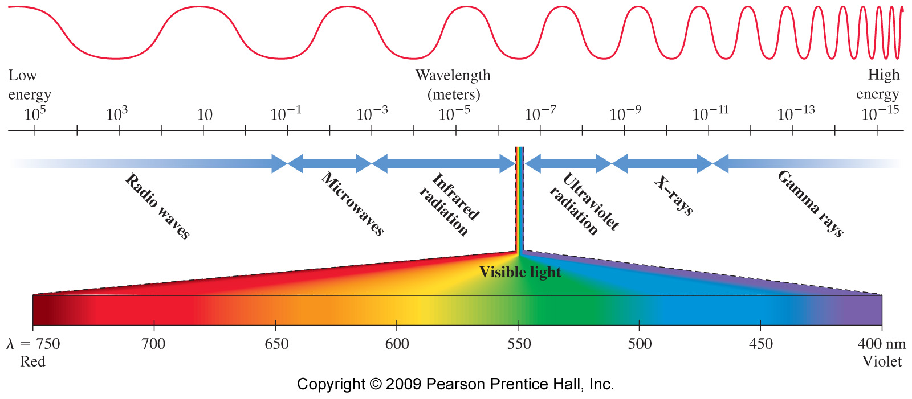
Electromagnetic Spectrum

Slide 39
The Electromagnetic Spectrum and Photon Energy
Short wavelength light have photons with highest energy = High frequency
  Radio wave photons have the lowest energy.
  Gamma ray photons have the highest energy.
High-energy electromagnetic radiation can potentially damage biological molecules.
  Ionizing radiation
  The waves fit between atom-atom bonds, and vibrate/shake the atoms loose.

Slide 40
Order the Following Types of Electromagnetic Radiation:
Microwaves (MW), Gamma Rays (GR), Green Light (GL), Red Light (RL), Ultraviolet Light (UV)
By wavelength (short to long).
Gamma < UV < green < red < microwaves.
By frequency (low to high).
Microwaves < red < green < UV < gamma.
By energy (least to most).
Microwaves < red < green < UV < gamma.

Slide 41
Stop at This Slide

Slide 42
Calculating energy, wavelength and frequency
C.6.C calculate the wavelength, frequency, and energy of light using Planck’s constant and the speed of light

Slide 43
C, frequency and wavelength
Wave speed, frequency and wavelength have a mathematical relationship.
  Using v = λ x ƒ , frequency or wavelength can be found. Remember light waves travel at 3.00 x10⁸ m/s.
    Example what is the wavelength of a wave of light if it has a frequency of 3.2 x 10¹⁴ hertz?

Slide 44
C, frequency and wavelength
Wave speed, frequency and wavelength have a mathematical relationship.
  Using v = λ x ƒ, frequency or wavelength can be found.
    Example what is the wavelength of a wave of light if it has a frequency of 3.2 x 10¹⁴ hertz?
      3.00 x 10⁸ m/s = λ x 3.2 x 10¹⁴ s⁻¹ solve for λ.
      λ = 3.00 x 10⁸ m/s = 9.4 x 10⁻⁷ m
        3.2 x 10¹⁴ s⁻¹

Slide 45
Wave speed, frequency and wavelength practice
Using v = λ x ƒ or,
  find the frequency of a 4.00 x 10⁻¹¹ m wavelength of the violet light.
  find the wavelength of a sound wave with a frequency of 440Hz. (Sound travels at ≈ 330 m/s).

Slide 46
Wave speed, frequency and wavelength practice
Using v = λ x ƒ or,
  find the frequency of a 4.00 x 10⁻¹¹ m wavelength of the violet light.
    7.5 x 10¹⁸ Hz
  find the wavelength of a sound wave with a frequency of 440Hz. (Sound travels at ≈ 330 m/s).
    0.75 m

Slide 47
Light Particles and Planck’s Constant
Particles of Light
Planck’s Constant
Scientists in the early 20th century showed that electromagnetic radiation was composed of particles we call photons.
  Max Planck and Albert Einstein.
  Photons are particles of light energy.
One wavelength of light has photons with that amount of energy.
Planck’s Constant is a physical constant reflecting the sizes of energy quanta (photons) in quantum mechanics.
  It is named after Max Planck, one of the founders of quantum theory, who discovered it in 1900.
The equation is E = hf where E = energy, h = Planck's constant (6.63 x 10⁻³⁴ J • s), and f = frequency.

Slide 48
  Using Planck’s equation, E = h x ƒ
Example 1: Solving for E using Planck’s Constant
Example 2: Solving for energy using wavelength and Planck’s Constant
What is the energy (Joules) of Violet light with a frequency = 7.50 x 10¹⁴ s⁻¹?
Find the energy of light, wavelength is 4.06 x 10⁻¹¹ m.

Slide 49
  Using Planck’s equation, E = h x ƒ
Example 1: Solving for E using Planck’s Constant
Example 2: Solving for energy using wavelength and Planck’s Constant
What is the energy (Joules) of Violet light with a frequency = 7.50 x 10¹⁴ s⁻¹?
    h =6.63 x 10⁻ ³⁴ J • s we then plug in our frequency into our formula and we get
    E = 6.63 x 10⁻³⁴ J • s x 7.50 x 10¹⁴ s⁻¹ =
      4.97 x10⁻¹⁹ J
Find the energy of light, wavelength is 4.06 x 10⁻¹¹ m.
    We first need to plug in the frequency-wavelength relationship so ƒ = c / λ.
    We then plug it into the energy equation, E = h x ( c / λ ) then we plug in all our numerical values.
    E = 6.63 x 10⁻³⁴ J • s x (3.00 x 10⁸ m/s /4.06 x 10¹⁴ m)
      E = 4.90 x 10⁻⁴⁰ J

Slide 50
Energy, wavelength and frequency practice
Answer the following problems. Remember that h=6.6 x 10⁻³⁴ J● s.
Energy = h x ƒ
What is the energy of a quantum of light with a frequency of 7.39 x 10¹⁴ Hz?
The energy for a quantum of light is 2.84 x 10⁻¹⁹ J. What is the frequency of this light?

Slide 51
Energy, wavelength and frequency practice
Answer the following problems. Remember that h=6.6 x 10⁻³⁴ J● s.
Energy = h x ƒ
What is the energy of a quantum of light with a frequency of 7.39 x 10¹⁴ Hz?
  4.88 x 10⁻¹⁹ J
The energy for a quantum of light is 2.84 x 10⁻¹⁹ J. What is the frequency of this light?
  4.30 x 10¹⁴ Hz

Slide 52
Stop at This Slide

Slide 53
Valence Electrons and Electron Configurations
C.6.E express the arrangement of electrons in atoms through electron configurations and Lewis valence electron dot structures

Slide 54
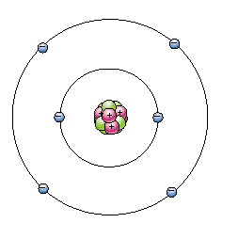
Valence Electrons
Valence electrons are electrons found on the outer energy shell of an atom
Electrons available to be lost, gained, or shared in the formation of chemical compounds.
Found in the highest energy level.
Valence electrons

Slide 55
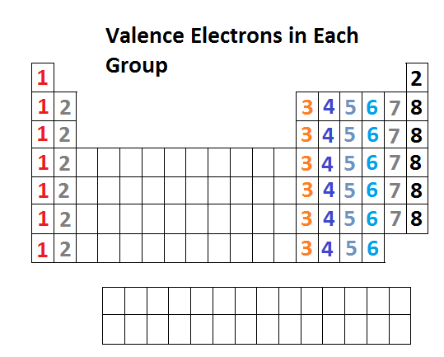
Valence Electrons
Elements in the same group (family) have the same number of valence electrons

Slide 56
Electron Configuration
Energy shells are divided into sub-shells as shown in the research of Erwin Schrödinger and Werner Heisenberg
The sub-shells are labeled as the s, p, d, and f sub-shells.
  The sub-shells each hold a certain number of orbitals
  Each orbital can hold 2 electrons
Electron configuration: A shorthand way to keep track of all the electrons in an atom of an element for all the sub-shells that have electrons. The number of electrons in each sub-shell is shown as a superscript.

Slide 57
Electron Configuration
Electron Shells (n= 1, 2, 3, 4…)
  The letter n represents the main shell or energy level.
The electron shells in the shell model of an atom (except for n =1) are divided into sub-shells.
Energy Level | # of electrons per energy level (2n²)
1 | 2
2 | 8
3 | 18
4 | 32

Slide 58
Electron Configuration
Electron Sub-Shells (s, p, d, and f)
  Each sub-shell is indicated by its main shell number and a letter, either s, p, d, or f.
The maximum numbers of electrons that can occupy s, p, d, and f sub-shells are 2, 6, 10, and 14, respectively
sub-shell | # of electrons in sub shell
s | 2
p | 6
d | 10
f | 14

Slide 59
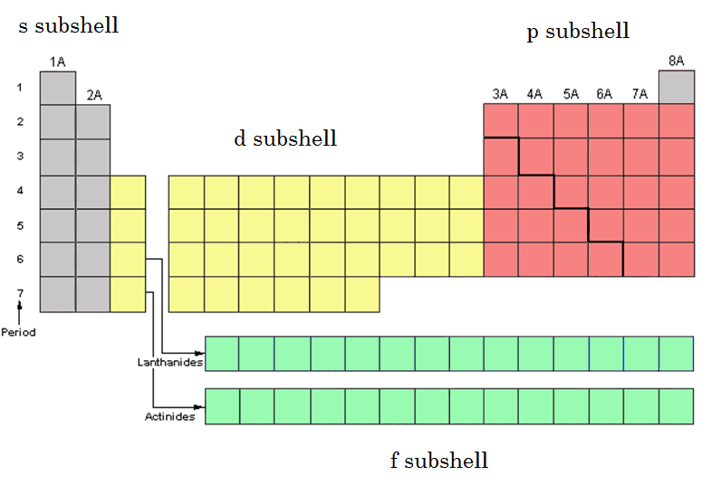
Electron Configuration
Sub-shells can be seen by the separation on the periodic table.
  Helium is part of the s sub-shell.

Slide 60
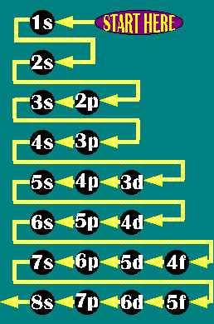
Electron Configuration
In an electron configuration,
  the number indicates the shell number
  the letter indicates the sub-shell within the shell
  the superscript indicates the number of electrons in the sub-shell.
The superscript numbers sum to the total number of electrons for an atom of the element.
  Example: carbon has six electrons and its electron configuration is 1s²2s²2p²
    2 +2 +2 =6 total electrons

Slide 61
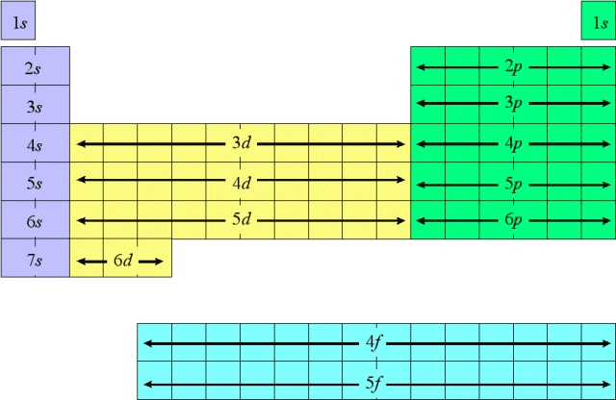
Electron Configuration and the periodic table
  The periodic table can be used to find the electron configuration for an element
    First find the element on the periodic table
    Then follow through each element block in order by stating the energy level, the orbital type, and the number of electrons per orbital type until you arrive at the element.

Slide 62
Guided Practice
Find the electron configuration for selenium, Se.
  Selenium is in the 4th energy shell, in the p sub-shell, and in the fourth column of the p sub-shell so its electron configuration should end in 4p^{4.}
  Just follow the fill order to write the electron configuration.
    1s²2s²2p⁶3s²3p⁶4s²3d¹⁰4p⁴
    Add up all the superscripts to check if the number equals selenium’s atomic number
      2 + 2 + 6 + 2 + 6 +2 +10 + 4 = 34 Se atomic # = 34

Slide 63
Practice
Write the following elements electron configurations.
  Li, Lithium
  K, Potassium
  Kr, Krypton
  Pb, Lead

Slide 64
Practice
Answers
  Li, Lithium
    1s²2s¹
  K, Potassium
    1s²2s²2p⁶3s²3p⁶4s¹
  Kr, Krypton
    1s²2s²2p⁶3s²3p⁶4s²3d¹⁰4p⁶
  Pb, Lead
    1s²2s²2p⁶3s²3p⁶4s²3d¹⁰4p⁶5s²4d¹⁰5p⁶6s²4f¹⁴5d¹⁰6p²

Slide 65
Noble Gas configuration
To write a noble gas (shorthand) configuration for any element, count backwards from that element until you reach a noble gas.
Write that element in brackets.
Then, continue forward with next sub-shell(s) - see the following version of the periodic chart that shows the sub-shell order with respect to the elements.

Slide 66
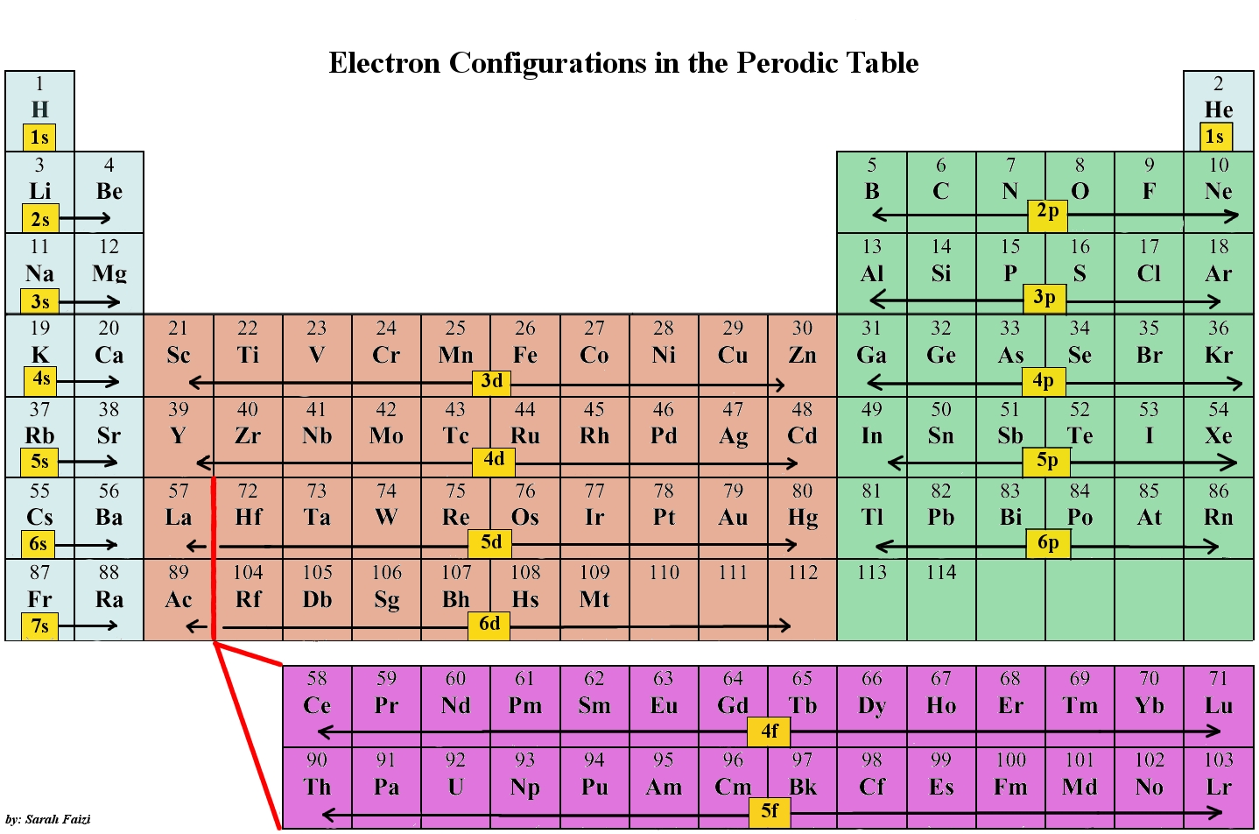
Noble Gas configuration
Noble Gases

Slide 67
Noble Gas configuration
For example, if we wanted to do the shorthand configuration for sodium (Na), you would count back one element to neon (Ne) and put Ne in brackets.
  [Ne]
Put this element symbol in brackets and then, noting that the next correct sub-shell is 3s, include the rest of the electrons as we did with the smaller elements.
  [Ne]3s¹

Slide 68
Practice
Write the following noble gas configuration for the following elements.
  Be, Beryllium
  F, Fluorine
  Pt, Platinum

Slide 69
Practice
Write the following noble gas configuration for the following elements.
  Be, Beryllium
    [He]2s²
  F, Fluorine
    [He]2s²2p⁵
  Pt, Platinum
    [Xe]6s²4f¹⁴5d⁸

Slide 70
Stop At this Slide

Slide 71
Lewis electron-dot structures
C.6.E express the arrangement of electrons in atoms through electron configurations and Lewis valence electron dot structures

Slide 72
Lewis electron-dot structure
Lewis electron-dot structures are pictures or representations of atoms and their valence (or outer shell) electrons.
  Electron dot structures show only the electrons in the valence or outer energy level.
  First the atomic symbol is written.
  Then the dots representing the valence electrons are put on each side of the atomic symbol.
    Each side must have at least one dot before dots can be paired up.
Lewis electron-dot structures are used to help determine how bonding will occur between atoms and the possible shapes that the molecules will form.

Slide 73

Lewis electron-dot structure
Sulfur
  Sulfur has 6 valence electrons

Slide 74
Practice
Draw the Lewis electron-dot structure for the following elements
  Hydrogen
  Phosphorus
  Bromine
  Nitrogen

Slide 75

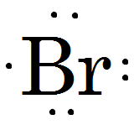

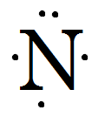
Practice
Answers
  Hydrogen
  Phosphorus
  Bromine
  Nitrogen

