Slide 1
Unit 1: Scientific Fundamentals

Slide 2
Table of Contents
Safety: MSDS
Accuracy and Precision
Significant Figures
Scientific Notation
Dimensional Analysis
Notes:
Add topics
-Significant Figures with Accuracy and Precision
-Scientific Notation

Slide 3
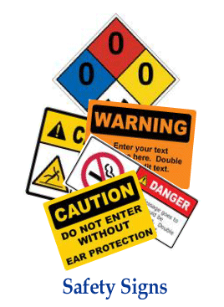
LABORATORY SAFETY:
MSDS
C.1.A demonstrate safe practices during laboratory and field investigations, including the appropriate use of safety showers, eyewash fountains, safety goggles, and fire extinguishers
C.1.B know specific hazards of chemical substances such as flammability, corrosiveness, and radioactivity as summarized on the Material Safety Data Sheets (MSDS)

Slide 4
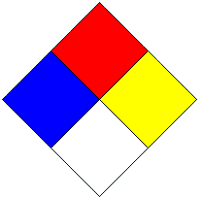
NFPA CHEMICAL HAZARD LABEL
FLAMMABILITY
RED
BLUE YELLOW
WHITE
HEALTH
SPECIAL
REACTIVITY
(Stability)

Slide 5
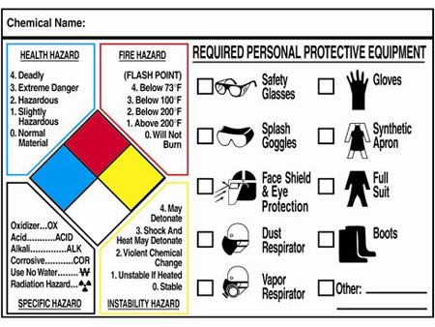
Health Hazard
Describe effects of chemical exposure to body, symptoms and what do in a medical emergency.
Fire Hazard
Describes how easily a chemical can catch fire.
Reactivity Hazard
Describes how unstable a chemical can be when in contact with another chemical or solution.
Specific Hazard
Describes any important specific Hazard, such the chemical it is most reactive with.

Slide 6
NFPA CHEMICAL RATINGS
0
Least
Serious
4
Most
Serious
4
1
0
0
4
Substance is stable
Flammable vapor which burns readily

Slide 7
NFPA CHEMICAL HAZARD LABEL
Methane
Burns readily.
Methane is nontoxic. It can, however, reduce the amount of oxygen in the air
necessary to support life.
Will not react when in contact with other chemicals.
4
0
SA
Simple Asphyxiant

Slide 8
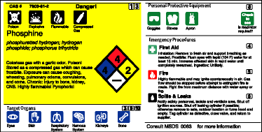
NFPA CHEMICAL HAZARD LABEL
Completed Label for Phosphine

Slide 9
Chemical Hazards
and Precautions
Possible Required Personal Protective Equipment

Slide 10
MSDS
Material Safety Data Sheet
On file for all purchased chemicals.
Includes all information shown on a chemical label and more.
Different formats are used by different chemical companies.

Slide 11
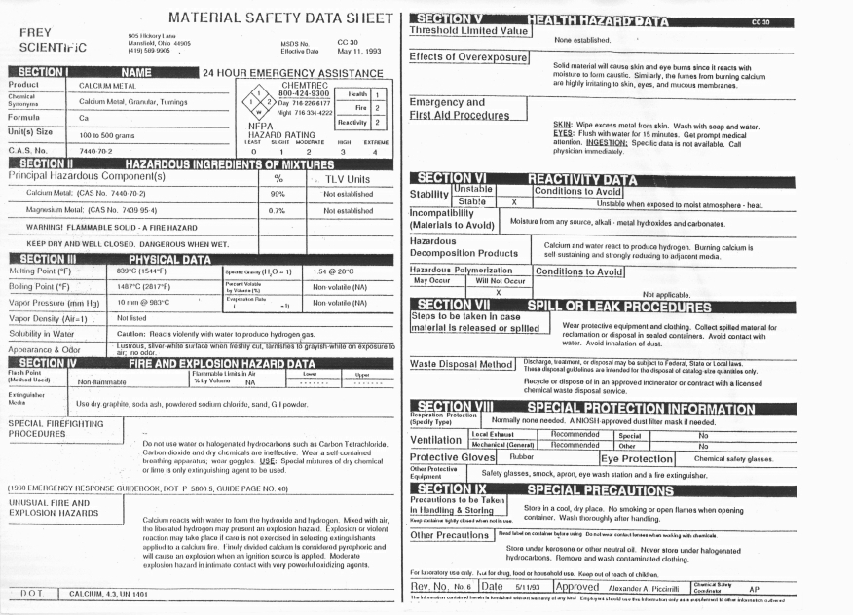

Slide 12


Slide 13
Scientific Method
Logical approach to the solution of scientific problems
Useful for solving many kinds of problems

Slide 14
Steps in the Scientific Method
1. Observation
-Information obtained through the senses.
-Often involve a measurement
2. Hypothesis
-Proposed explanation for observations.
-Most contain both an independent and dependent variable.
-Independent variable
-What you manipulate to test the reaction
-Dependent variable
-What changes as a result of your manipulation

Slide 15
Example:
It was hypothesized that as the temperature of a solvent increases, the rate at which a solute will dissolve in that solvent increases.
Independent variable= temperature
Dependent variable = rate of dissolving

Slide 16
3. Experiment
- Carefully controlled, repeatable procedure for gathering data to test a hypothesis
-For the results of an experiment to be accepted, the
experiment must produce the same results no
matter how many ties it is repeated or by whom.
Control group
-Group not exposed to the test condition.

Slide 17
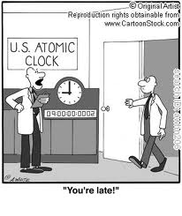
Accuracy and Precision
C.2.F collect data and make measurements with accuracy and precision

Slide 18
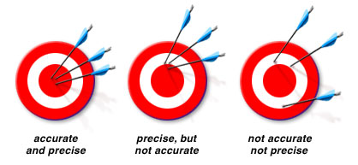
Measurements work best when they are accurate and precise
Accuracy is a measure of how close a measurement comes to the actual or true value of whatever is measured. Correctness Poor Accuracy results from procedural or equipment flaws | Precision is a measure of how close a series of measurements are to one another. depends on more than one measurement. Reproducibility Check by repeating Measurements Results from poor technique

Slide 19
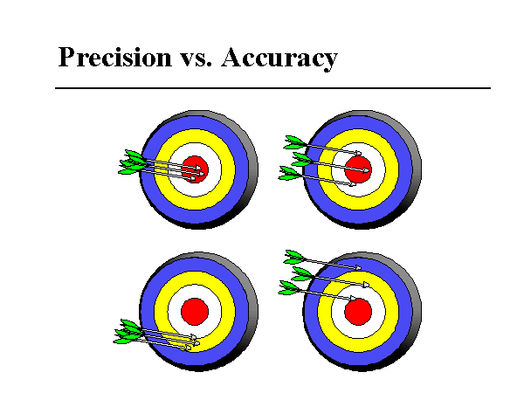
Accuracy VS Precision

Slide 20
good precision and accuracy |  | Example: The density of water is 1.0g/ml. You experimental values were: 1.0g/ml, 1.0 g/ml, 1.0g/ml, 1.0g/ml, 1.0g/ml
good precision, but poor accuracy |  | The density of water is 1.0 g/ml. Your experimental values were: 0.89 g/ml, 0.80 g/ml, 0.89 g/ml, 0.88 g/ml, 0.89 g/ml

Slide 21
poor precision, but good accuracy |  | The Atomic mass of Carbon is 12.01 amu’s Your experimental values were 11.95 amu’s 12.01 amu’s 11.97 amu’s 11.98 amu’s 12.03 amu’s
poor accuracy and poor precision |  | The Atomic mass of Carbon is 12.01 amu’s Your experimental values were 11.95 amu’s 11.30 amu’s 10.91 amu’s 11.09 amu’s 12. 53 amu’s

Slide 23
Significant Figures
C.2.G express and manipulate chemical quantities using scientific conventions and mathematical procedures, including dimensional analysis, scientific notation, and significant figures

Slide 24
ChemCatalyst
In Lab or when doing a formula problem in chemistry, How do you determine where to round the number? How many decimal places to keep?

Slide 25
It is important to be honest when reporting a measurement, so that it does not appear to be more accurate than the equipment used to make the measurement allows. We can achieve this by controlling the number of digits, or significant figures, used to report the measurement.

Slide 26
Significant Figures
All non-zero numbers are significant. | 12.34 4 sig figs
Zeros between non-zero figures are significant. | 10,204 5 sig figs
Zeros before the first non zero number are not significant. | 0.01234 4 sig figs

Slide 27
Zeros After the last non-zero figure are not significant unless they are followed by a decimal point or they are to the right of a decimal point. | 123,400 4 sig figs 123,400. 6 sig figs 12.3400 6 sig figs

Slide 28
How many Sig Figs?
23.505
620
0.062
620
2500
2500.
250.0
5
2
2
2
2
4
2

Slide 29
Addition and Subtraction
The sum or difference of measurements should be rounded to the place value of the least precise measurement. (The lowest number of decimal places)
  123.567 3 decimal places 987.654 3 decimals
  78.9 1 decimal place - 32.10 2 decimals
  63.25 2 decimal places 955.554
  + 372.644 3 decimal places
  638.361
955.55
638.4

Slide 30
Multiplication and Division
The product of quotient of measurement should have the same number of significant figures as the least precise measurement.
(You must count significant figures….not decimal places)
10.6 cm 3 sig. fig
x 12.3 cm 3 sig. fig
130.38 cm²
825g / 1100 cm³ = .75 g/cm³
.75 g/cm³
130. cm²

Slide 31
Significant Figures of Scientific Notation
When counting significant figures with scientific notation, all of the numbers in front of the x 10^{n} are significant.
3 x10³ 1 significant figures
3.0 x10³ 2 significant figures
3.00 x10³ 3 significant figures

Slide 33
SCIENTIFIC NOTATION
C.2.G express and manipulate chemical quantities using scientific conventions and mathematical procedures, including dimensional analysis, scientific notation, and significant figures

Slide 34
The radius of the Milky Way Galaxy
is 390,000,000,000,000,000,000 meters!
(19 zeros)
This number is written in decimal notation. When numbers get this large, it is easier to write them in scientific notation.
3.9×10²⁰

Slide 35
Scientific notation is a convenient way to write a very small or a very large number.
Numbers are written as a product of a number between 1 and 10, times the number 10 raised to power.
N x 10^{x}
For example, 215 is written in scientific notation as: 2.15 x 10²

Slide 36
When changing scientific notation to standard notation, the exponent tells you if you should move the decimal:
With a positive exponent, the number gets larger move the decimal to the right:
4.08 x 10³ ⁼ 408
.
0
Don’t forget to fill in your zeroes!
2.898 x 10⁸
5.67 x 10⁴
289800000
Try These
Examples
56700

Slide 37
When changing scientific notation to standard notation, the exponent tells you if you should move the decimal:
With a negative exponent, the number gets smaller move the decimal to the left:
4.08 x 10⁻³ = 4 08
.
0
0
Don’t forget to fill in your zeroes!
531.42 x 10⁻⁵
1.428 x 10⁻³
.0053142
Try These
Examples
.001428

Slide 38
Now try changing these from Scientific Notation to Standard form
96780
9.678 x 10⁴
7.4521 x 10⁻³
8.513904567 x 10⁷
4.09748 x 10⁻⁵
.0074521
85139045.67
.0000409748

Slide 39
Now try changing these from Standard Form to Scientific Notation
9872432
.0000345
.08376
5673
9.872432 x 10⁶
3.45 x 10⁻⁵
8.376 x 10⁻²
5.673 x 10³

Slide 41
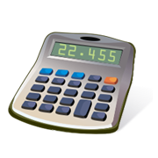
Dimensional Analysis
C.2.G express and manipulate chemical quantities using scientific conventions and mathematical procedures, including dimensional analysis, scientific notation, and significant figures

Slide 42
Dimensional analysis is a problem-solving method that uses the idea that any number or expression can be multiplied by one without changing its value.
Dimensional analysis is used to convert one unit of measurement to another unit of measurement using conversion factors.
These Conversion Factors are fixed and unchanging relationships.
I. What is Dimensional Analysis?

Slide 43
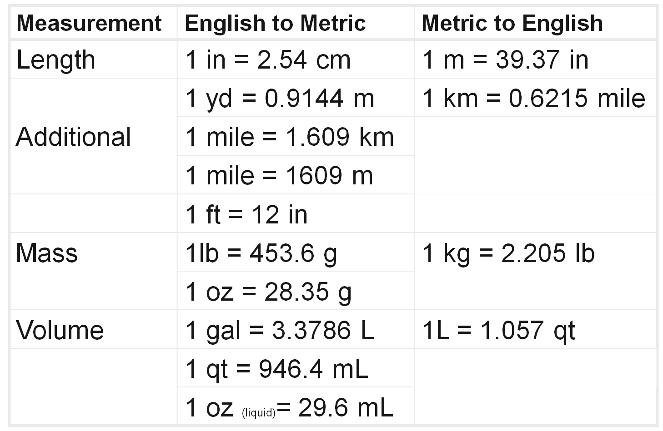
II. Useful Conversions factors:

Slide 44
III.How do you do Dimensional Analysis?
There are 5 Steps
Start with what value is known, proceed to the unknown.
2. Draw the dimensional lines or fence (count the “jumps”).
3. Insert the Conversion Factor.
4. Cancel the units.
5. Do the math, include units in answer.

Slide 45
IV. How do you set up a problem?
Using conversion factors and the following set up we can jump from unit to unit in a breeze!
Box #1 Write the value that needs to be converted. ( ( | Box # 3 One side of the Conversion factor
Box #2 Write a “1” in the denominator | Box # 4 One side of the Conversion factor (same unit as in box #1)
(Given)

Slide 46

V. Lets try Example #A
How many Slices are there in 7 Pizzas?
Given: 7 Pizzas
Want: Slices
Conversion: 1 Pizza=8 Slices

Slide 47
Solution
Check your work…
Now do the Math! Multiply and divide by denominator.
7 Pizzas
8 Slices
56 Slices
1
=
1
1 Pizza
Conversion factor

Slide 48
Example B…
How old are you in days?
Given: 17 years
Want: # of days
Conversion: 365 days = one year

Slide 49

Solution
Check your work…
17 Years
365 Days
6056 Days
1
=
1 Year
1

Slide 50
Example C
There are 2.54 cm in one inch. How many inches are in 17.3 cm?
Given: 17.3 cm
Want: # of inches
Conversion: 2.54 cm = one inch

Slide 51
Solution
Check your work…
17.3 cm
1 in
6.81 in
1
=
2.54 cm
1

Slide 52
Converting Complex Units
-Many measurements are expressed as a ratio of two units.
Ex: density = g/cm³
-Require two conversion factors.
Ex: Convert 305 cm/s to km/hr.

Slide 54
Percent Error & Density
Percent error
-Absolute value of the accepted value – the experimental value, divided by accepted; multiplied by 100.
Percent error = accepted value – experimental value x 100
accepted value
Ex: You measure the temperature of the room and get 32.1ºC. The actual room temperature is 21.2 ºC. What is your percent error?

Slide 55
Density
-Ratio of the mass of an object to its volume.
-Intensive property
Density = mass
volume
Ex: A copper penny has a mass of 3.1 g and a volume of 0.35 cm³. What is the density of copper?

