Slide 1
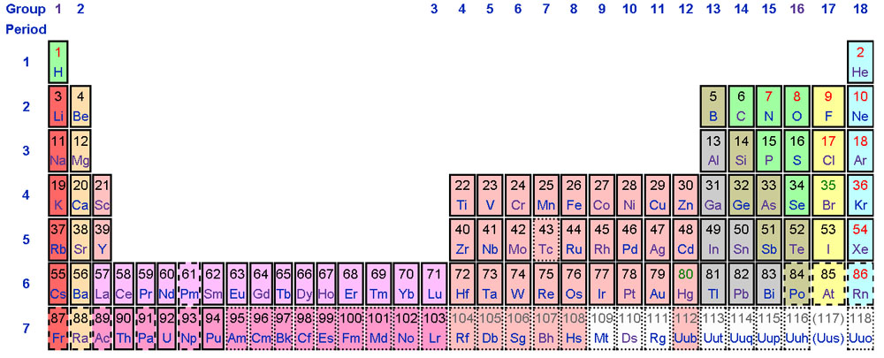
EXTENDED Periodic Table

